Slide 1
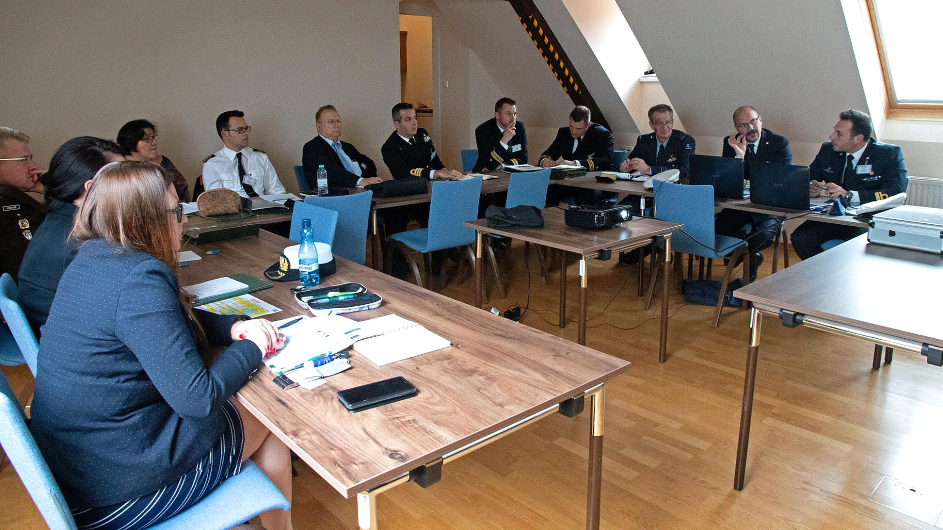
Introduction to Syndicate Work
Lisbon/Portugal
iMAF 2021
managing future challenges
Syndicate Work during iMAF 2019 (Austria)
Photo: Theresan Military Academy

Slide 2
GAREA Recommendations Procedure
BOEI 1:
Contributions
to GAREA
BOEI 2:
Contributions
to GAREA
BOEI 3:
Contributions
to GAREA
BOEI 4:
Contributions
to GAREA
BOEI 5, etc.:
Contributions
to GAREA
Implementation Group:
Discussion about the GAREA recommendations
IG Chairman:
Passes message
ESDC Executive Academic Board
GAREA recommendations for the IG
ESDC Steering Committee
iMAF 2021
Topics for
syndicate work

Slide 3
GAREA Recommendations Contents
Return to prior pandemic mobilities for students, teachers and Staff as fast as possible, as long as the SARS-CoV-2-situation allows it. Develop in parallel online learning to keep the momentum and to provide pre-conditions of ERASMUS+ financial support for short students’ mobilities.
Integrate the SQF-MILOF elaborations into the descriptions of existing and future common modules, wherever possible.
Develop clear guidelines for financial support of exchanges.
Finalisation and implementation of the international semesters starting with pilot projects (Air Force, Navy, Technical) and initiating elaborations on an international medical semester.
Develop clear guidelines for Basic Officer Education Institutions for the next European Universities call 2024.
Increase Research & Development activities and collaboration, not only among Basic Officer Education Institutions, but also with civilian universities.

Slide 4
Syndicates: Chairpersons & Topics
Syndicate No. | Chair | Topic
1 | Assist. Prof. KARAMPELAS Panagiotis, PhD (EMILYO Chairperson LoD 12) | International Air Force Semester
2 | WYSOCKA Monika, MA (Coordinator SPP International Naval Semester) | International Naval Semester
3 | Col Eng. GONTARCZYK Mariusz, PhD, MSc (Member SPP International Technical Semester) | International Technical Semester
4 | LtCol MACHADO Paulo, MSc (EMILYO Chairperson LoD 7) | Short duration modules: financing and support
5 | Capt-Cdr Assoc. Prof. Eng. MOLDOVEANU Cristian Emil, PhD (EMILYO Chairperson LoD 13 / Specialist European Univ.) | European University: way ahead
6 | LtCol SPINELLO Enrico (EMILYO Chairperson LoD 8) | Medium and long term duration mobilities for lecturers: how to increase and improve them
7 | Assoc. Prof. TEMPLALEXIS Ioannis, PhD (EMILYO Chairperson LoD 14) | Research and development: state of the art and future possibilities
8 | Assist. Prof. MENEZES Sofia, PhD ? | Cadets’ / Midshipmen’s evaluation of exchanges

Slide 5
Syndicate 1 Expected Outcomes
Syndicate Chair: Assist. Prof. KARAMPELAS Panagiotis, PhD
Syndicate No. | Topic | Expected Outcomes
1 | International Air Force Semester | Continuation of the SPP elaborations Up-dated information concerning the elaborations Achievements What is still when to do Up-dated timeline

Slide 6
Syndicate 2 Expected Outcomes
Syndicate Chair: WYSOCKA Monika, MA
Syndicate No. | Topic | Expected Outcomes
2 | International Naval Semester | Continuation of the SPP elaborations Up-dated information concerning the elaborations Achievements What is still when to do Up-dated timeline
Remark: There are only few participants for syndicate 2 ➔ probably some of you can change?

Slide 7
Syndicate 3 Expected Outcomes
Syndicate Chair: Col Eng. GONTARCZYK Mariusz, PhD, MSc
Syndicate No. | Topic | Expected Outcomes
3 | International Technical Semester | Continuation of the SPP elaborations Up-dated information concerning the elaborations Achievements What is still when to do Up-dated timeline
Remark: Coordination with LoD 13 Chairperson

Slide 8
Syndicate 4 Expected Outcomes
Syndicate Chair: LtCol MACHADO Paulo, MSc
Syndicate No. | Topic | Expected Outcomes
4 | Short duration modules: financing and support | Guidelines “how to do it?” (word document) How to co-finance cadets/midshipmen? How to (co-)finance the organisers? Understandable for newcomers

Slide 9
Syndicate 5 Expected Outcomes
Syndicate Chair: Capt-Cdr Assoc. Prof. Eng. MOLDOVEANU Cristian Emil, PhD
Syndicate No. | Topic | Expected Outcome
5 | European University: way ahead | Information paper “for Commandants / Superintendents” (word document) Which are the benefits? What we have to do for it?
Take care: We will not create a 2nd EMILYO
If needed: Coordination with LoD 9 Chairperson (based on elaborations 2 weeks ago)

Slide 10
Syndicate 6 Expected Outcomes
Syndicate Chair: LtCol SPINELLO Enrico
Syndicate No. | Topic | Expected Outcome
6 | Medium and long term duration mobilities for lecturers: how to increase and improve them | Information paper (word document) Pre-conditions Benefits Financing

Slide 11
Syndicate 7 Expected Outcomes
Syndicate Chair: Assoc. Prof. TEMPLALEXIS Ioannis, PhD
Syndicate No. | Topic | Expected Outcome
7 | Research and development: state of the art and future possibilities | Information: what has been achieved so far? Future possibilities (continuation of LoD 14 work) Coordination with syndicate 5 (probably there are possibilities?)

Slide 12
Syndicate 8 Expected Outcomes
Syndicate Chair: Assist. Prof. MENEZES Sofia, PhD ?
Syndicate No. | Topic | Expected Outcome
8 | Cadets’ / Midshipmen’s evaluation of exchanges | When, where, which exchange (e.g.: int’l semester, common module, internship, ….) Achieved knowledge, skills and competences (1 key-word for each) Personal conclusion
At least 1 Cadet should remain in the original syndicate – the others create syndicate 8 (those with exchange experiences)
More different exchanges can be presented
All together not more than 10 minutes

Slide 13
Syndicates 1-7 Presentations of Outcomes
Presentation (word or power point or both)
Duration: <10 minutes
Start: 22 Sep after lunch
Kind request: send all elaborations / briefings / documents to IG Chairman ➔ upload to http://www.emilyo.eu/node/1191

Slide 14
thank YOU
for YOUR
attention!

